Slide 1
Morsel and Robot Presentation
Jessie Wu

Slide 2
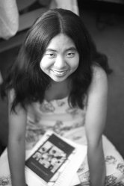
Ching-In Chen

Slide 3
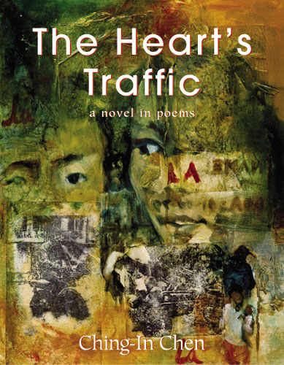
Daughter of Chinese immigrants
Kundiman and Lambda Fellow
Worked in the Asian American communities of San Francisco, Oakland, Riverside and Boston as a community organizer
Author of The Heart’s Traffic
Co-editor of The Revolution Starts at home: Confronting Intimate Violence Within Activist Communities and Here is a Pen: an Anthology of West Coast Kundiman Poets
Won an Oscar Wilde honorable mention for “Two River Girls”, a poem from The Heart’s Traffic.
Graduated from Tufts University, MFA in Creative Writing and Writing for the Performing Arts from the University of California, Riverside and is currently in the PhD program at the University of Wisconsin, Milwaukee
Notes:
novel-in-poems chronicles the life of Xiaomei, an
immigrant girl haunted by the death of her best friend. Told through a kaleidoscopic braid of stories, letters, and riddles, this stunning debut collection follows Xiaomei’s life as she grows into her sexuality and searches for
a way to deal with her complicated histories.

Slide 4
Favorite Passage
“To love your own violent histories,
the remembered soup of your failings,
and to forgive those who have failed before you,
generation upon generation,
of the most mad,
the most terrible,
the deadliest secrets crossing the ocean.
We do not bury our dead, but hack them into shanks we lay on our backs,
bearing them forever into each new world.”
-excerpt from The True Tale of Xiaomei

Slide 5
Xiaomei’s Father, Again
Here, in the song between two still bodies, is a new man she does not recognize.
Black Reebok sneakers. Faded blue jeans streaked with sweat. Plaid shirt stuffed
hastily into the waistband. Over this, an olivegreen coat thick as snow.
Xiaomei’s father, an ocean.
Notes:
Here, we can see the image of a father who leaves home for America, and returns fully Americanized. I think we are all able to recognize black Reebok sneakers, faded blue jeans, and the plaid shirt. Maybe we’ve worn those before and are even wearing them now. For Xiaomei, it becomes a cultural shock for her to find her father in clothes like these. She describes him as a “new man”. Yet clothes are only an outside representation of how much her father changed during the trip over to America. At this point, she feels lost and has a feeling of doubt in her life. And we can see this more in the last sentence, when the poet uses the word “an ocean” to describe Xiaomei’s father. When we think of the ocean, we think of deep, vast, never ending. I think the poet was trying to show the great divide between Xiaomei’s father and the rest of the family, because he has been to America. Whether or not Xiaomei is comfortable crossing that ocean becomes the main question in her life—whether or not she is ready for that leap from her past cultures and background to a new world.
This poem actually makes me think of whenever I visit China, my cousins tell me that I have an American feel to how I act and dress. Though they could not quite grasp what’s different between them and me but it definitely makes me feel like a person from a different world despite the fact that we come from the same blood and have the same skin color.
I think this passages also ties back into Ching-In’s family history, of being a daughter of Chinese immigrants. Her poem explores the concept of community and self, the process of discovering where we do or do not belong through our simultaneous attempts to blend and resist multiple worlds and identities.

Slide 6
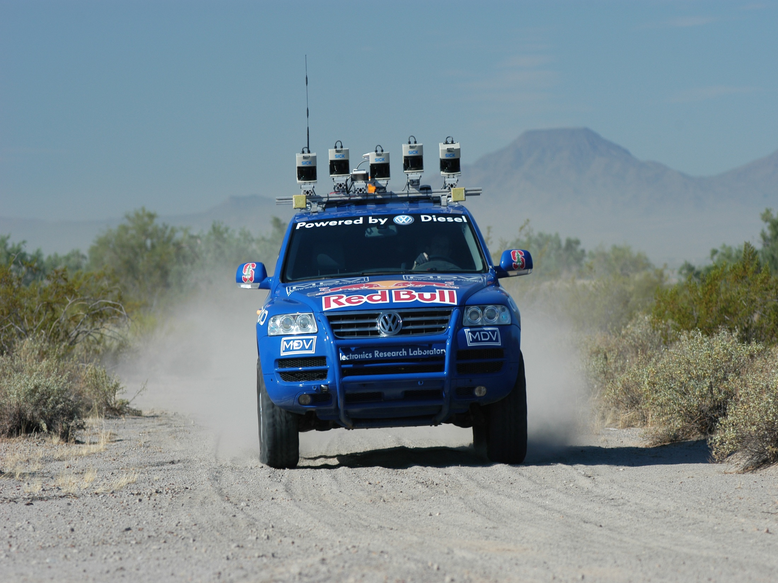
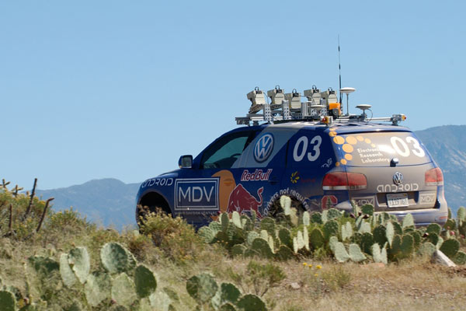
Stanley

Slide 7
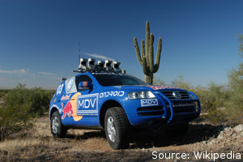
Autonomous car created by Stanford Racing Team & Volkswagen Electronic Research Laboratory
Won 2005 DARPA Grand Challenge
Driverless car competition
Currently located at the Smithsonian National Air and Space Museum
Equipped with six low-power 1.6 GHz Intel Pentium M based computers in the trunk, running different versions of the Linux operating system
Characterized by Machine Learning
a log of “human reactions and decision”—greatly reduced error and more accurate in detecting shadows
Notes:
Machine Learning is a branch of artificial intelligence, concerns the construction and study of systems that can learn from data. For example, a machine learning systems could be trained on email message to learn to distinguish between spam and non-spam message. After learning, it can then used to classify new email message into spam and non-spam folders.
To correct common errors made by Stanley early in development—the Stanford Racing Time created a log of “human reactions and decision” and fed the data into a learning algorithm tied to the vehicle’s controls

Slide 8
Writing Prompts
MORSEL
ROBOT
What does it mean to be “Americanized”? To what extent do you feel like you have been “Americanized”?
With the idea of machine learning, humans are transferring a great amount of human intelligence into machines. Do you think there still exists something that robots may not be able to learn from humans ?

Slide 9
Race Track:
Three narrow tunnels and more than 100 sharp left and right turns
Concluded through Beer Bottle Pass, a winding mountain pass with sheer drop-offs on both sides

